Slide 1
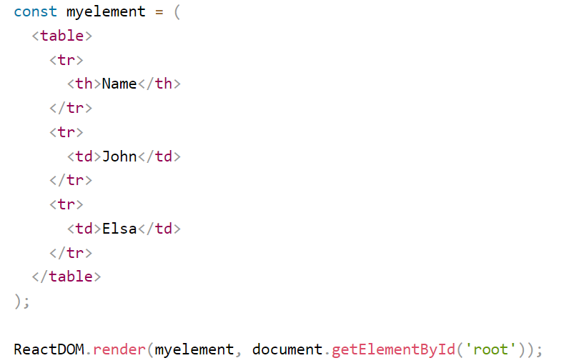
React Render HTML
React renders HTML to the web page by using a function called ReactDOM.render()
The ReactDOM.render() function takes two arguments, HTML code and an HTML element.
The render() function is to display the specified HTML code inside the specified HTML element.
The HTML code is rendered in index.html page.
ReactDOM.render(<p>Hello</p>, document.getElementById('root'));
<body> <div id="root"></div> </body>

Slide 2
React Render HTML
ReactDOM.render(<p>Hello</p>, document.getElementById('root'));
<body> <div id="root"></div> </body>

